Slide 1
Hypotheses testing for a population proportion
Traditional method

Slide 2
Steps
Testing a claim about a population proportion follows the same basic steps as we used in hypotheses testing for a population mean.
When testing about a population proportion we can say that we test for:
A proportion (Ex: Test the claim that more than ½ of the grade 12 students enroll in an extra semester);
A percentage (Ex: Test the claim that less than 23% of the population of Toronto has blue eyes);
A probability (Ex: Test the claim that there is a 0.57 probability that the voters in Toronto will vote for the Liberal Party).

Slide 3
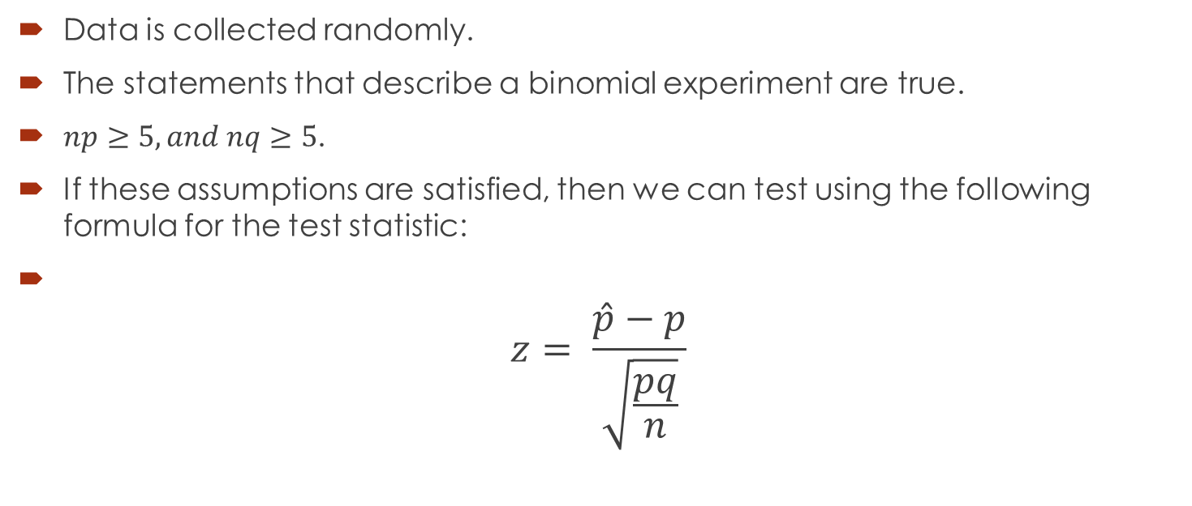
Assumptions
Data is collected randomly.
The statements that describe a binomial experiment are true.
$np≥5, and nq≥5$.
If these assumptions are satisfied, then we can test using the following formula for the test statistic:
$$z= \frac{\hat{p}−p}{\sqrt{\frac{pq}{n}}}$$

Slide 4
Example
In a study of air-bags effectiveness, it was found that in 821 crashes of midsize cars equipped with air bags, 46 of the crashes resulted in hospitalization of the drivers. Use a 0.01 significance level to test the claim that the air bag hospitalization rate is lower than 7.8% rate for crashes of midsize cars equipped with automatic safety belts but no air bags.

Slide 5

Solution
Step 1.
$H_{0}:p=0.078$
$H_{1}:p<0.078$
Step 2. The significance level is given and equal to 0.01.
We construct the critical region by reading the value of z This value is:
Z = - 2.33

Slide 6
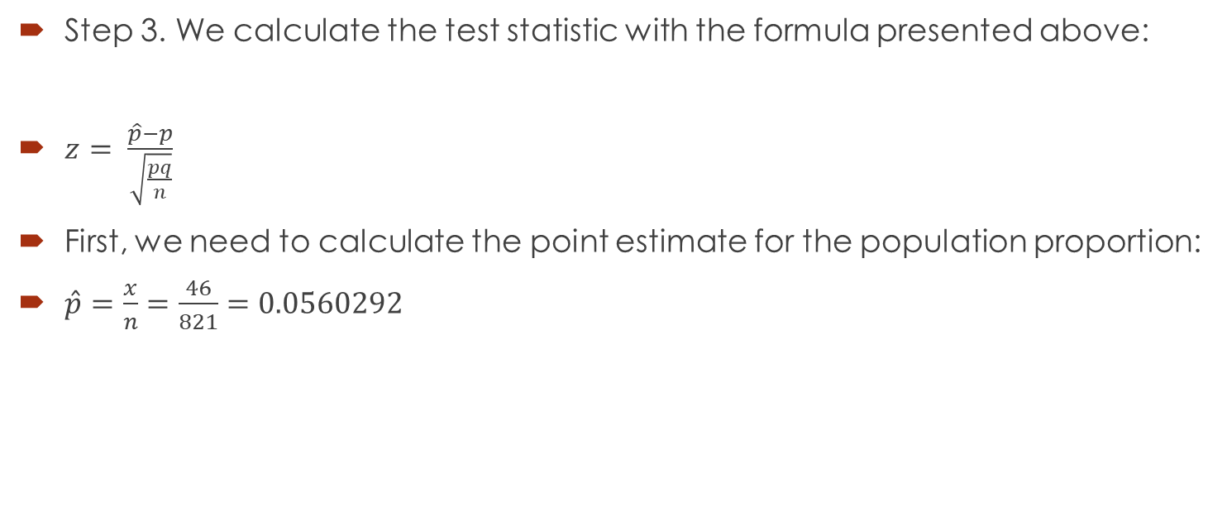
Solution continued
Step 3. We calculate the test statistic with the formula presented above:
$z= \frac{\hat{p}−p}{\sqrt{\frac{pq}{n}}}$
First, we need to calculate the point estimate for the population proportion:
$\hat{p}=\frac{x}{n}=\frac{46}{821}=0.0560292$

Slide 7
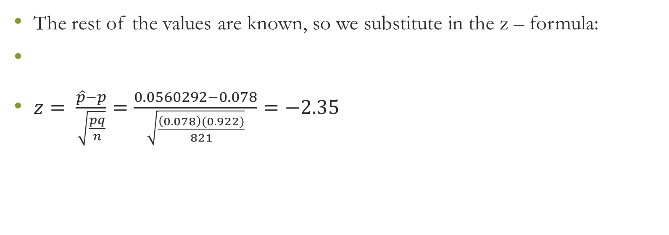
Solution continued
The rest of the values are known, so we substitute in the z – formula:
$z= \frac{\hat{p}−p}{\sqrt{\frac{pq}{n}}}=\frac{0.0560292−0.078}{\sqrt{\frac{\left(0.078\right)(0.922)}{821}}}=−2.35$

Slide 8
Solution continued
Step 4. When we compare the observed value of z to the critical value, we see that the value is inside the critical region, we make the decision to reject the null hypothesis.
Step 5. With a 99% level of confidence we can say that there is enough evidence to support the claim that the air-bag hospitalization rate is lower than the 7.8% rate for automatic safety belts.

Slide 9
Practice
1. According to a study, 84% of U.S. children ages 8 to 18 had Internet access at home as of August 2009. Researchers wonder if this number has increased since then. The original sample consisted of 500 children, and 86% of them had Internet access at home. Test the researchers’ claim at 5 % level of significance.

Slide 12
2. Data from the Center for Disease Control estimates that about 30.4% of American teenagers were overweight in 2008.
A professor in public health at a major university wants to determine whether the proportion has decreased since 2008. He samples 800 randomly selected incoming freshman at universities around the country. Using the BMI measurements, he finds that 210 of them are overweight.
If the professor uses a significance level of 0.10, what conclusion can he draw?

Slide 15
3. The NCHS report indicated that in 2002, 75% of children aged 2 to 17 saw a dentist in the past year. An investigator wants to assess whether use of dental services is similar in children living in a certain city. A sample of 125 children aged 2 to 17 living in that city are surveyed and 64 reported seeing a dentist over the past 12 months. Is there a significant difference in use of dental services between children living in that particular city and the national data?

Slide 18
4. Ships arriving in ports in a certain country are inspected by Customs officials for contaminated cargo. Assume, for a certain port, 20% of the ships arriving in the previous year contained cargo that was contaminated. A random selection of 50 ships in the current year included 5 that had contaminated cargo. Does the data suggest that the proportion of ships arriving in the port with contaminated cargoes has decreased in the current year? Use α=0.01.

